Slide 1


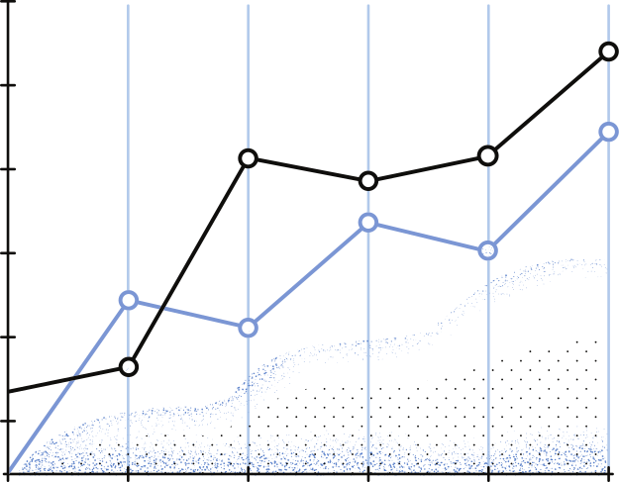

LaborLens: Analyzing & Predicting Qatar’s Workforce Trends
- Joy Anne De LaCruz
- Djihane Mahraz
- Urooj Shah
- Tehreem Masroor
- Sidra Amina
- Fiza Gafoor
1

Slide 2



Agenda
1.
7.
Project Overview
Our Dashboard
2.
Our Approach
8.
What's Next ?
3.
Data
4.
Data Aggregated
5.
Screenshots and Demonstrations
6.
Model Performance
2

Slide 3

Project Overview
Focus: Descriptive and predictive analysis of Qatar's labour market.
Key Insights: Based on economic activity, gender, education level, and GDP.
Target Audience: Policymakers, researchers, and businesses.
Purpose:
Understand labour market trends.
Support informed decision-making.
3

Slide 4
Our Approach
Data Cleaning
Data Cleaning: Aggregated data, standardized categories, and ensured consistency.
Descriptive Analysis
Descriptive Analysis: Identified key labour trends using statistics and visuals.
Predictive Modelling
Predictive Modelling: Built time series models to forecast monthly average wages.
Visualization
Visualization: Designed interactive dashboards for clear data presentation
4

Slide 5
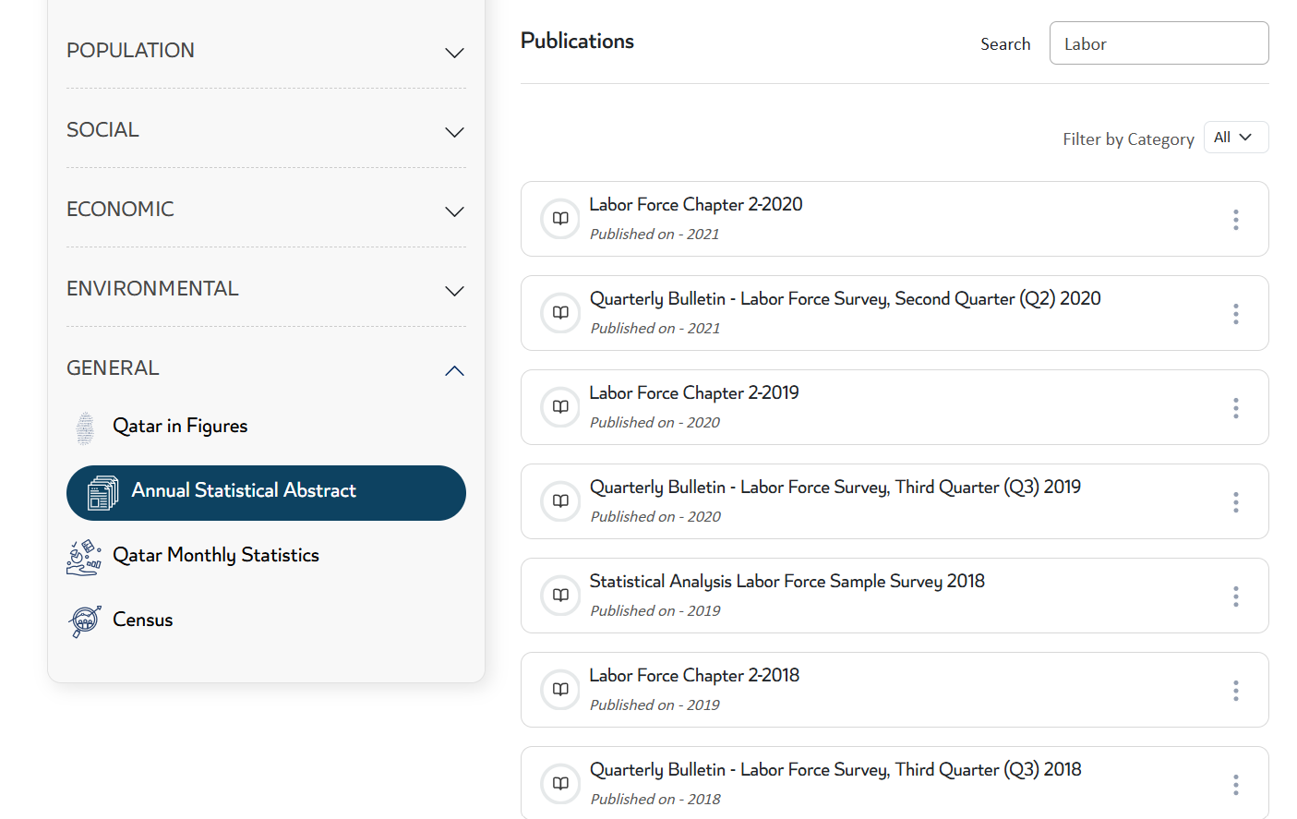
Data
5

Slide 6
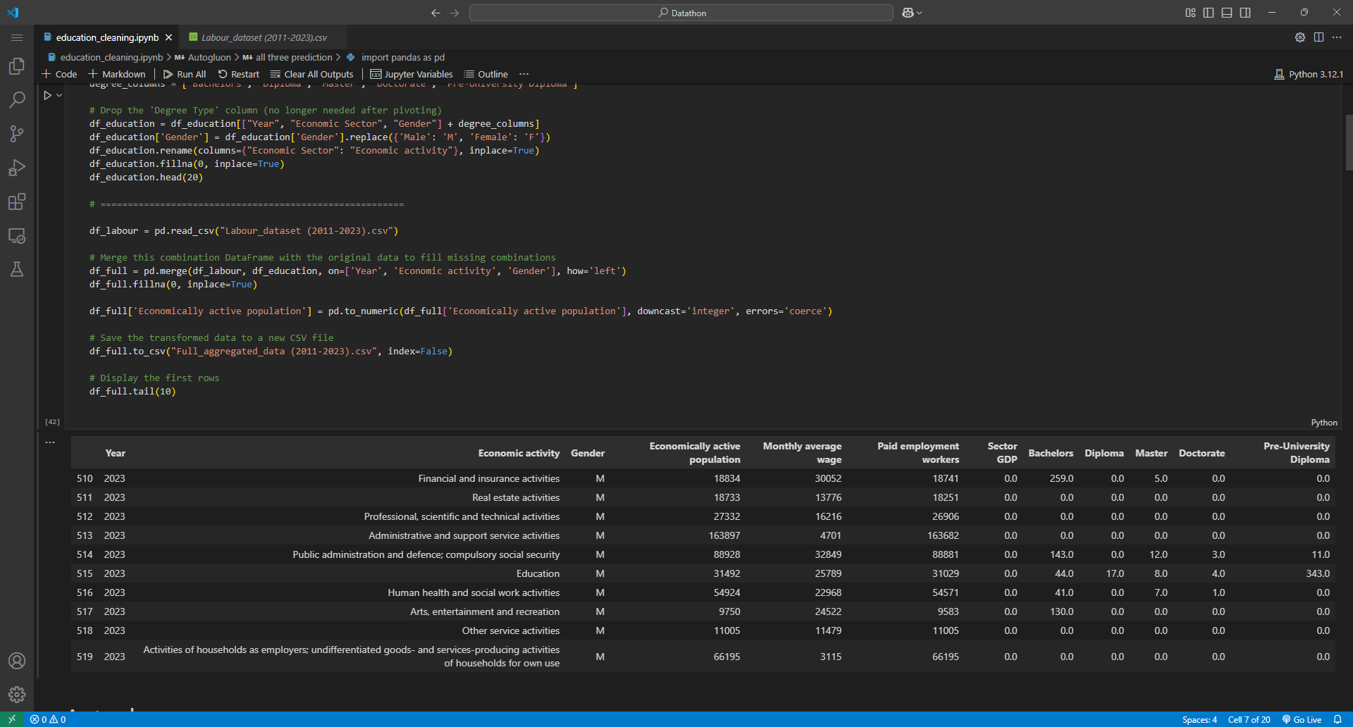
6

Slide 7
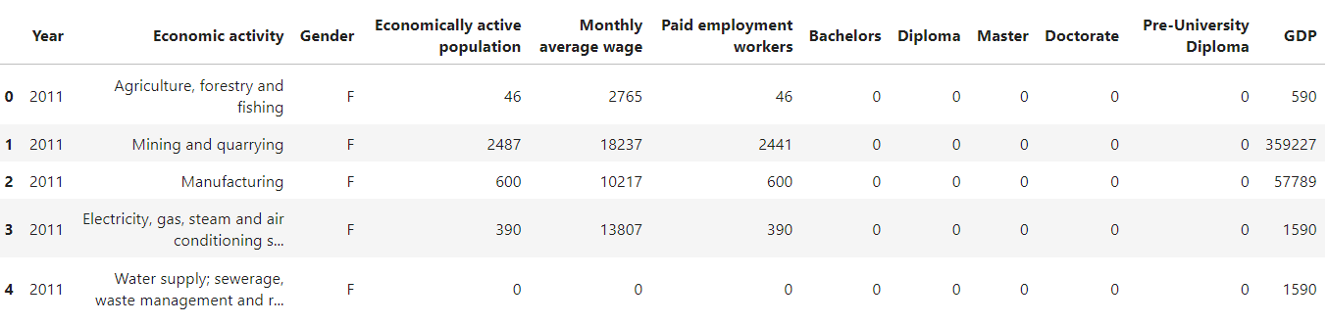
Data Aggregated
7

Slide 8
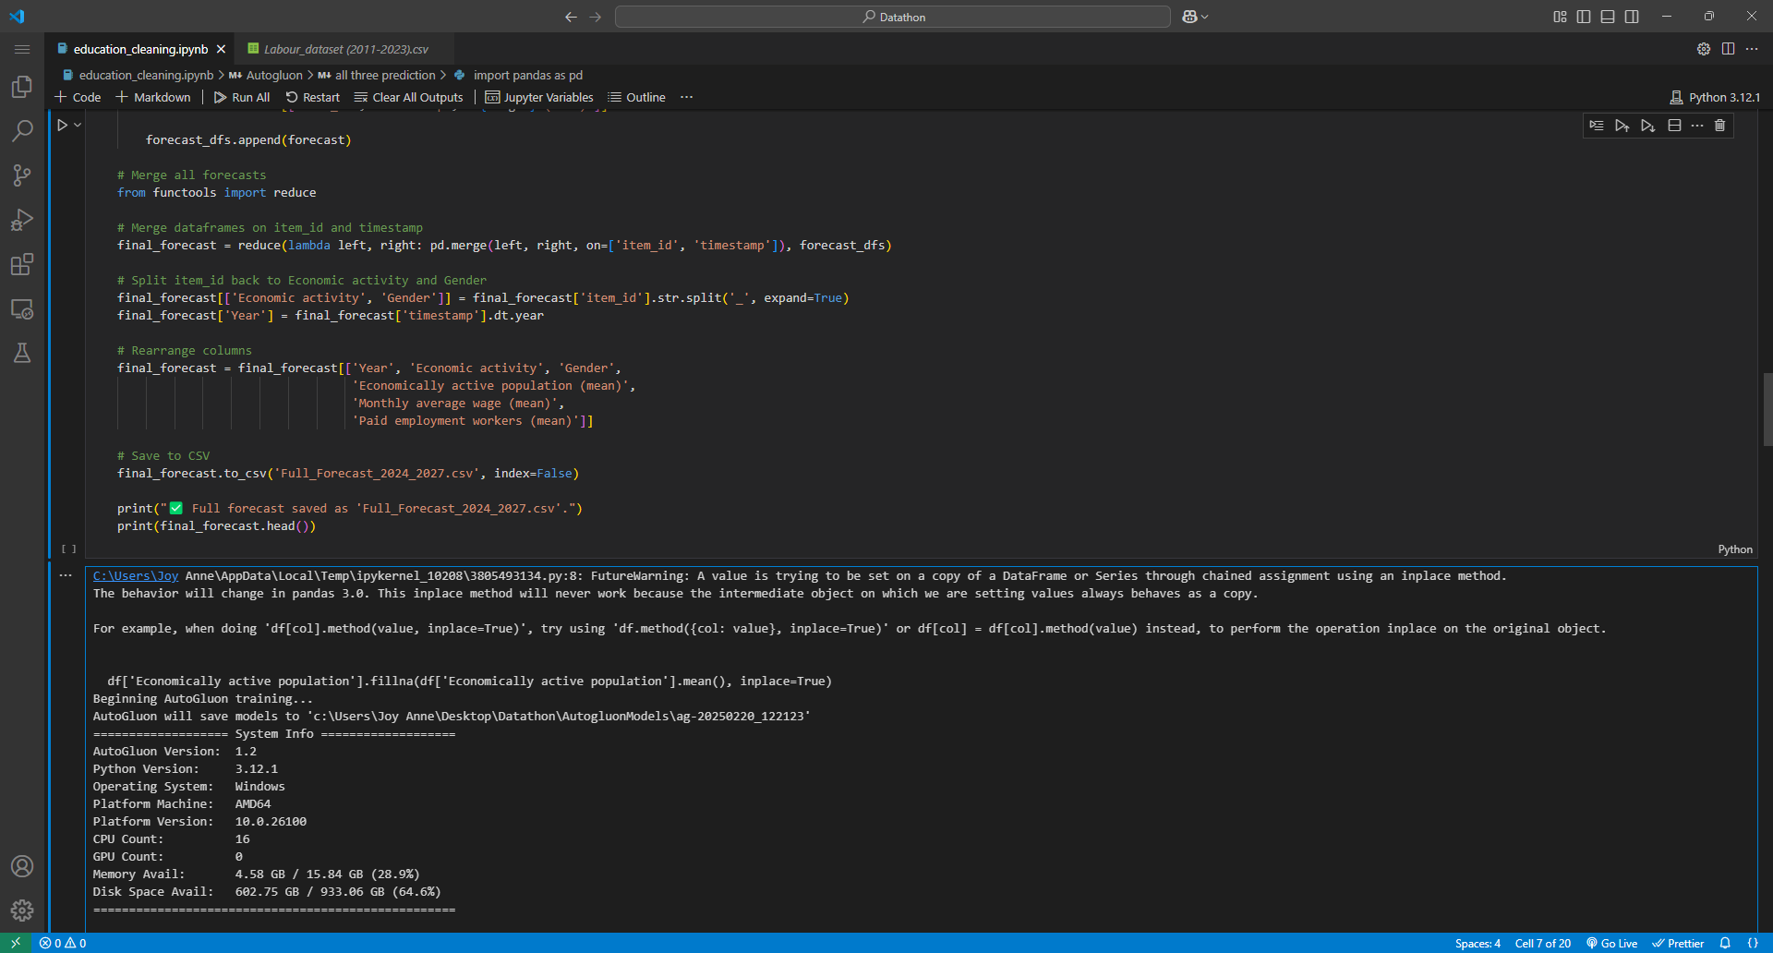
Screenshots and Demonstrations
8

Slide 9
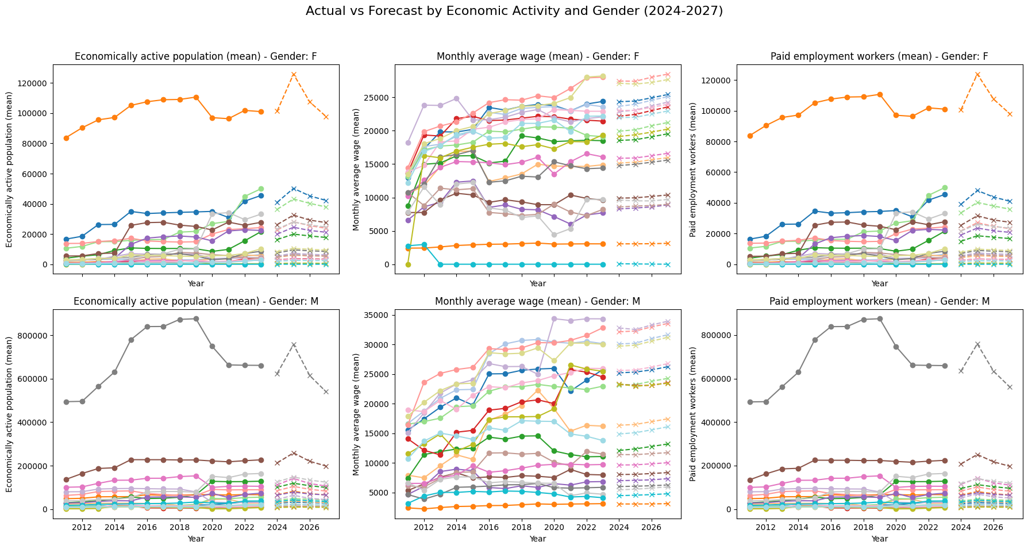
Model Performance
9

Slide 10
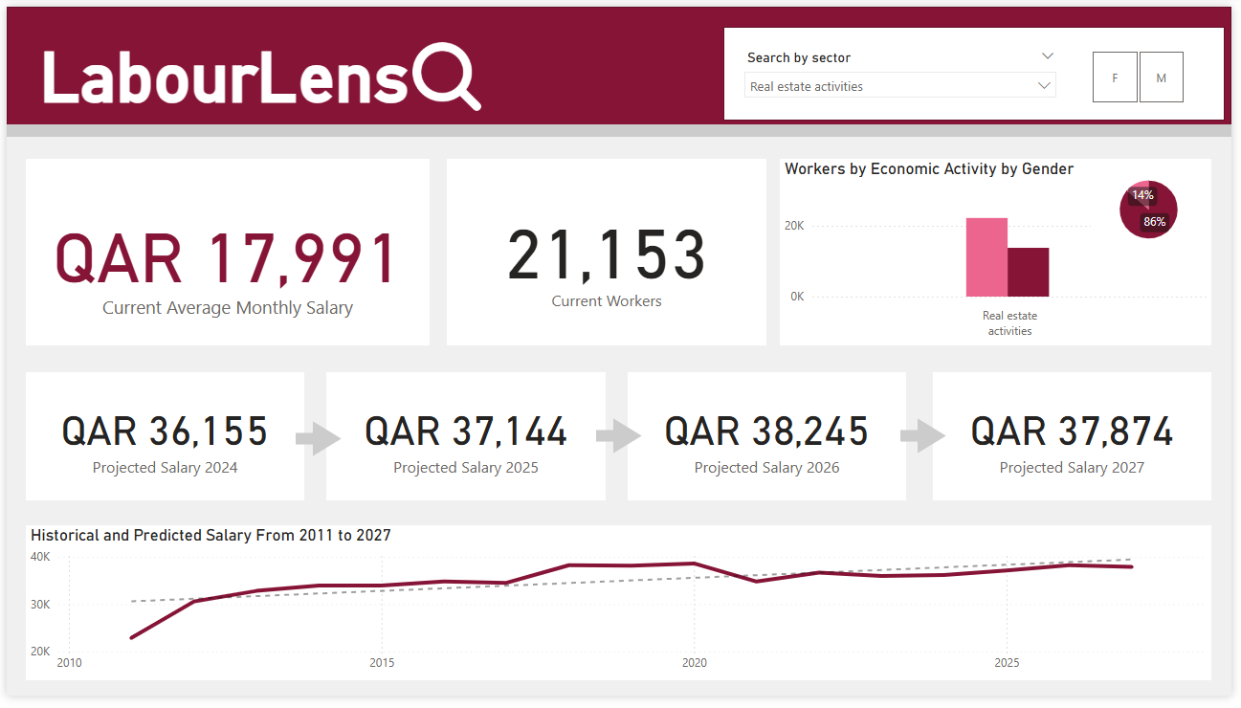
Our Dashboard
10

Slide 11
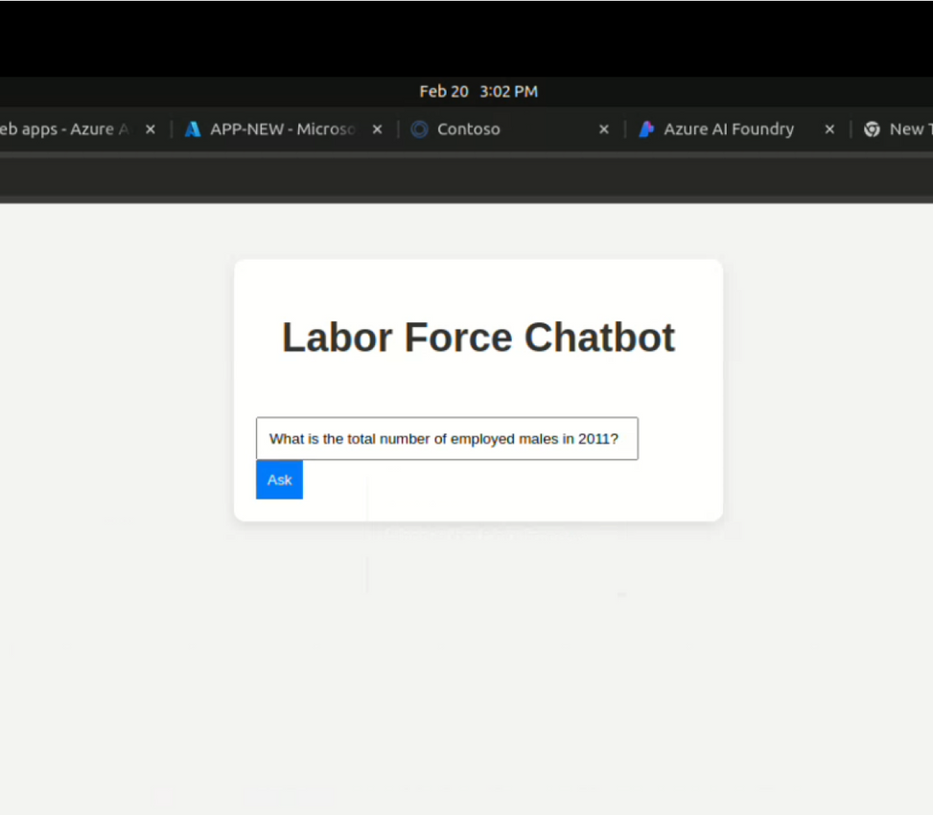
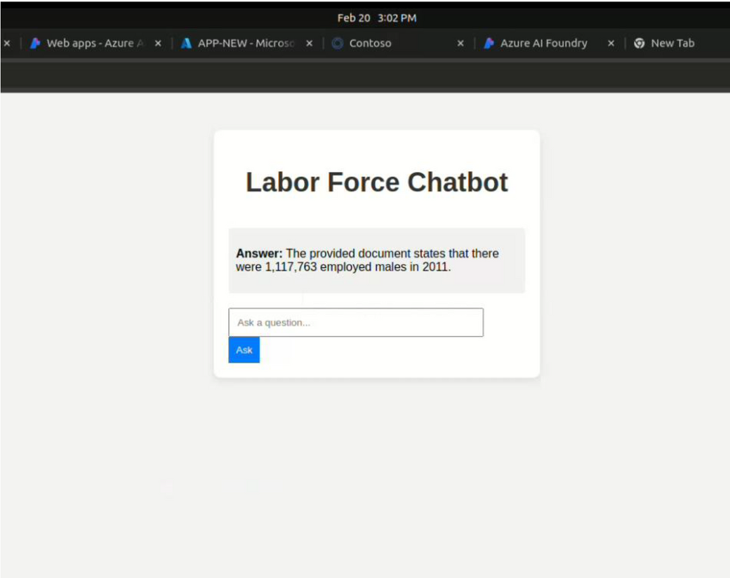

What's Next ?

Slide 12
Thank you!
Any Questions?
12

